Slide 1
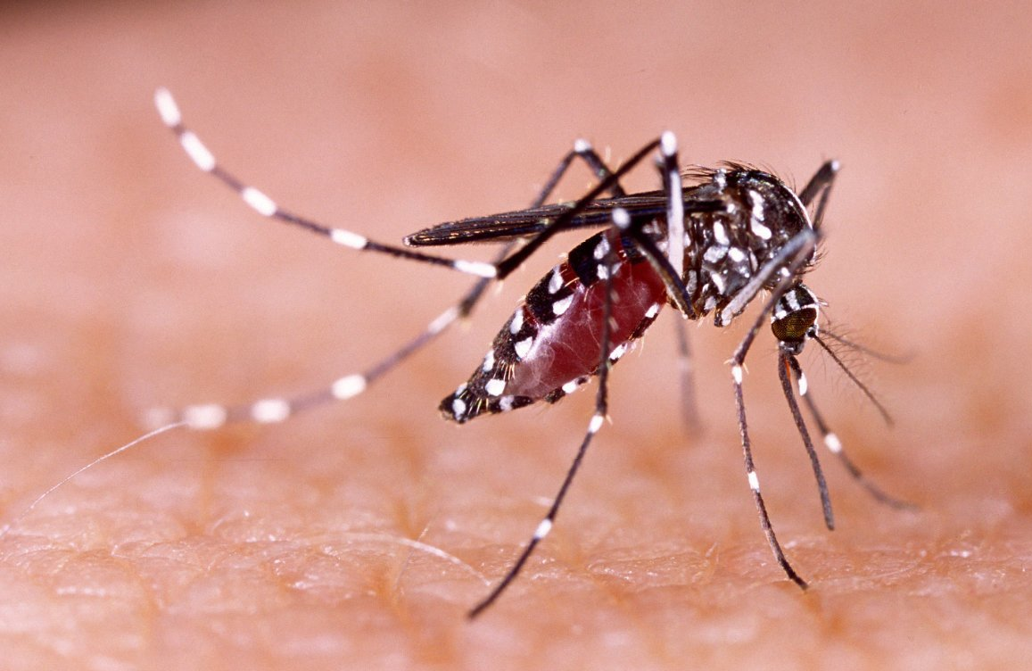
Temperature sensitivity of Dengue in Thailand
Project Proposal
Thaddeus Kühn, Dana Levi, Fiona Tanner, Frederik Racky
https://www.wissenschaft.de/wp-content/uploads/2/0/20-01-17-dengue.jpg

Slide 2
Overview
Data Background
Methods Milestones
Ideas Timeline

Slide 3
Datasets
TEMPERATURE
ERA5 database
Monthly 2m temperature
2006 - 2022
DENGUE
*Database*
Total monthly infections per district
POPULATION
Notes:
ERA5 Data:
measurements, reanalysis of climate data since 1959 (hourly, 0,25°x 0,25° spatial resolution, 137 altitude levels (max. 80 km)
Extraction of monthly 2m temperature data from 2006 - 2022

Slide 4
Climate
Seasons: (monsoon may - oct, dry winters)
Trends: rising min and max temperature in northern thailand, no significant rise in max in spring (Masud et al.)

Slide 5
Dengue

